Slide 1


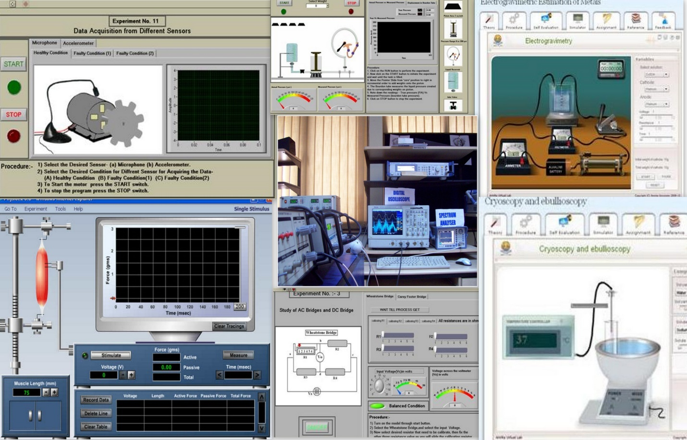
Virtual Labs
IIT Delhi, IIT Kanpur, IIT Bombay, IIT Madras, IIT Kharagpur, IIT Guwahati,
IIT Roorkee, Amrita University,
IIIT Hyderabad, Dayalbagh University, NIT Surathkal, COE Pune
http://vlab.co.in
VIRTUAL LABS

Slide 2
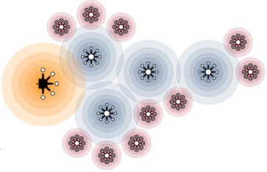


Motivation
Physical Distances Limit Doing Experiments
Sharing of Costly Equipment
Proliferation of Quality Labs

Slide 3

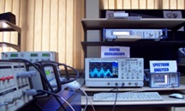

The basic idea
Remote User 1
Physical Lab
(located remotely)
Remote User 2
Internet
Remote User n

Slide 4

Objectives of the Virtual Lab Project
To provide remote-access to labs in various disciplines of Science and Engineering.
To cater to students at the UG level, PG level as well as to research scholars.
To enable the students to learn at their own pace, and to arouse their curiosity.
To provide a complete Learning Management System that includes web-resources, video-lectures, animated demonstrations and self evaluation.

Slide 5




Types of Virtual Labs
Remote Triggered
CLOSER TO REALITY
Measurement Based
SCALABILITY
Modeling / Simulation Based

Slide 6


Intended Users
College Students who do not have access to good lab-facilities.
Researchers in different institutes who can collaborate / share equipment and resources.
High-school students, whose inquisitiveness will be triggered, possibly motivating them to take up higher-studies.
Different engineering colleges, who can benefit from the content and related teaching resources.

Slide 7














Participating Institutes
IIT Delhi
IIT Bombay
IIT Kanpur
IIT Kharagpur
IIT Madras
IIT Roorkee
Amrita University
IIT Guwahati
I IIIT Hyderabad
Dayalbagh University
NIT Karnataka
COE Pune

Slide 8



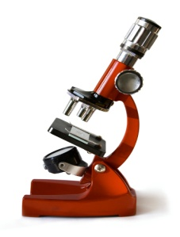
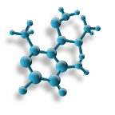
Broad Areas for Virtual Labs
Electronics and Communication Engineering
Computer Science and Engineering
Electrical Engineering
Mechanical Engineering
Civil Engineering
Chemical Engineering
Biomedical and Biotechnology Engineering
Chemical Sciences
Physical Sciences
All areas of Science and Engineering are covered

Slide 9
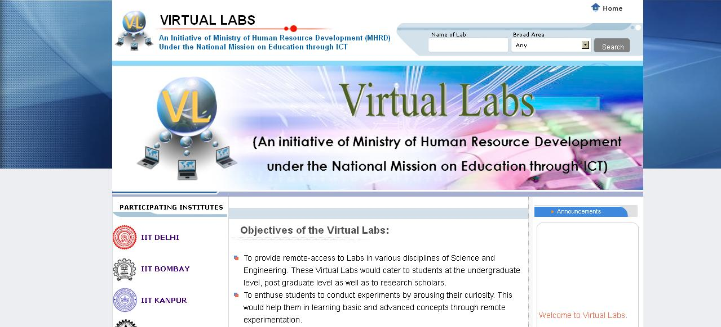
Website: www.vlab.co.in
One common website to access all Virtual Labs

Slide 10
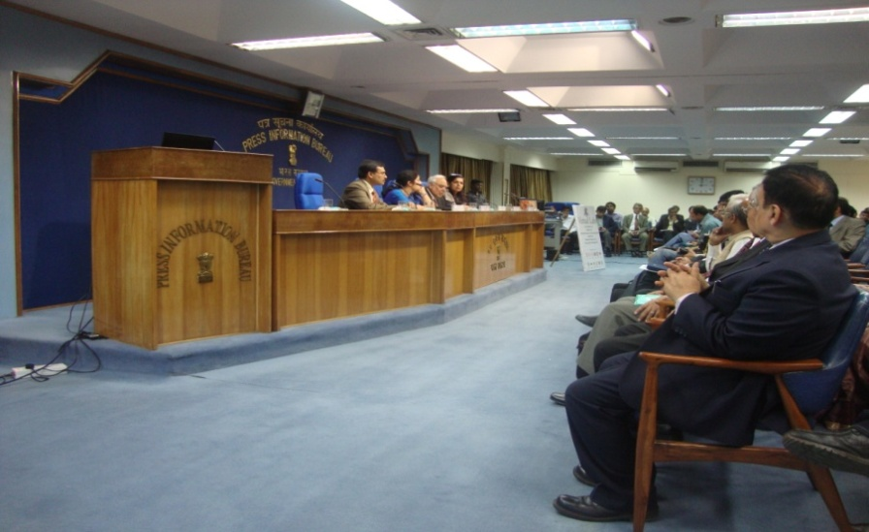
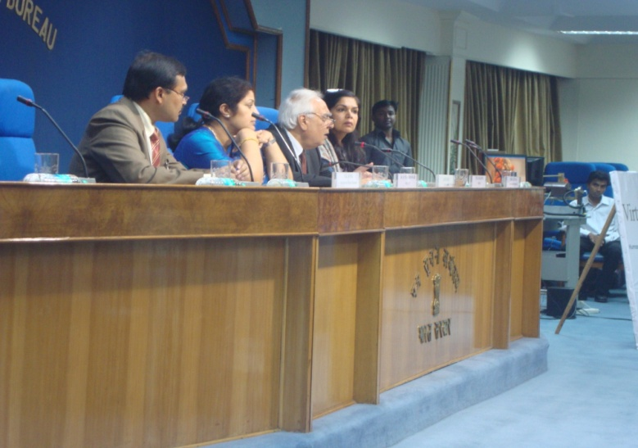
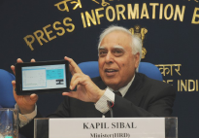
Virtual Labs ‘Launch’
Virtual Labs has been Dedicated to the Nation
on 23rd Feb, 2012.
Virtual Lab on Akash Tablet

Slide 11
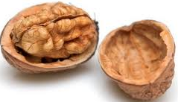
Value Add in a Nutshell
On-demand Labs
[learn at own pace]
Integrated Learning
[contents at one place]
Self - Evaluation
[pre /post lab quiz]
Animation/Video Tut
[better insight]
Freedom to make mistakes
[can experiment with experiments]
Virtual Labs - A Complete Learning Management System

Slide 12

Development of a novel process for Field Trials

Slide 13
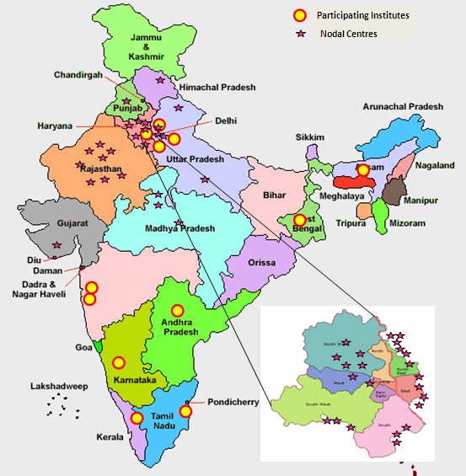
Field Trials of ECE, CSE & Applied Science
Total Number of Nodal Centres : 48

Slide 14
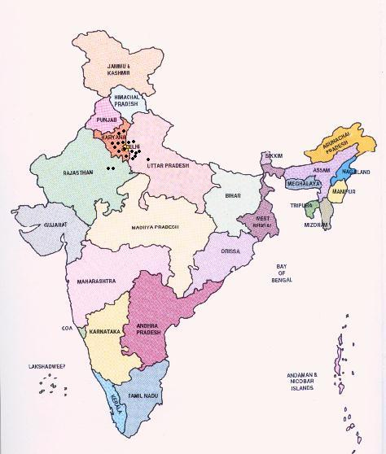
NATIONAL IMPACT
Field Trials conducted in over 100 Colleges
More than 1000 Faculty Trained
Participating Institutes
36 Workshops Conducted
More than 50000 Students Trained

Slide 15
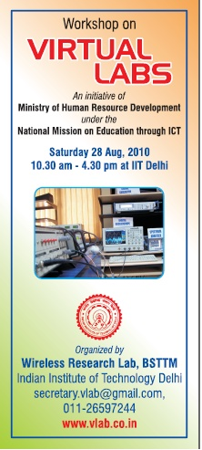
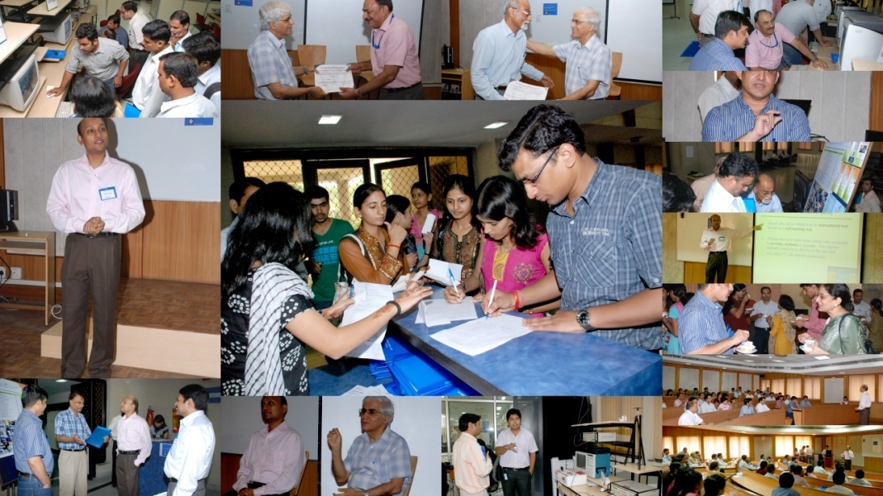
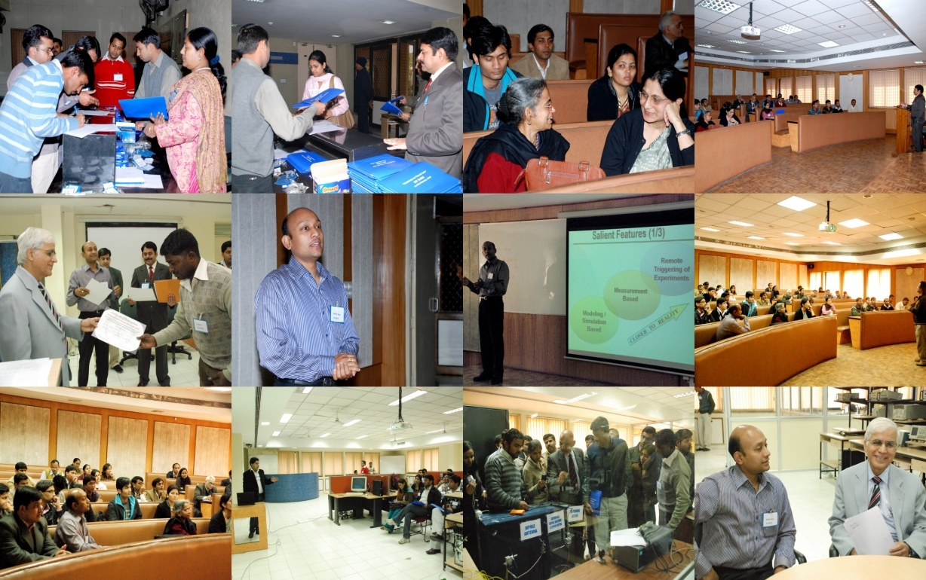

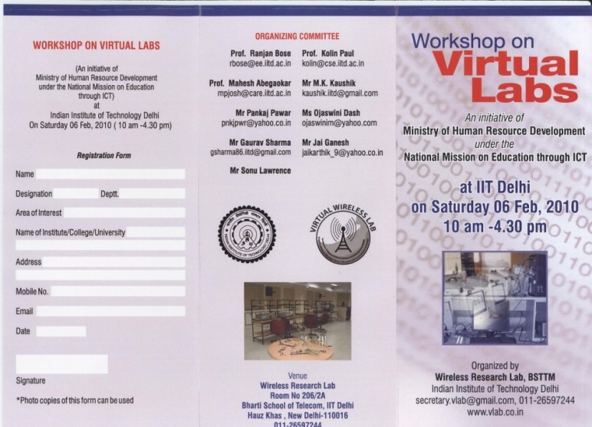
WORKSHOPS

Slide 16
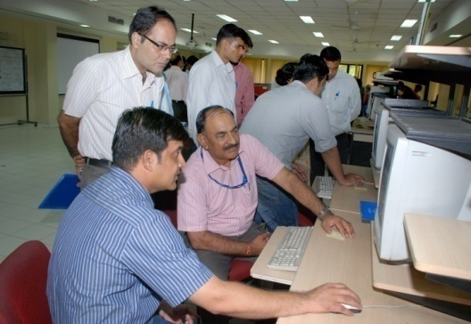
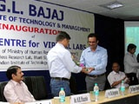
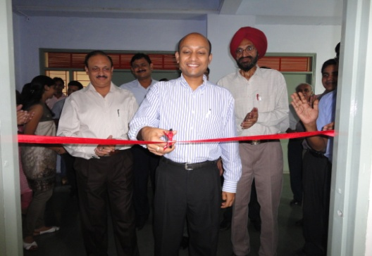
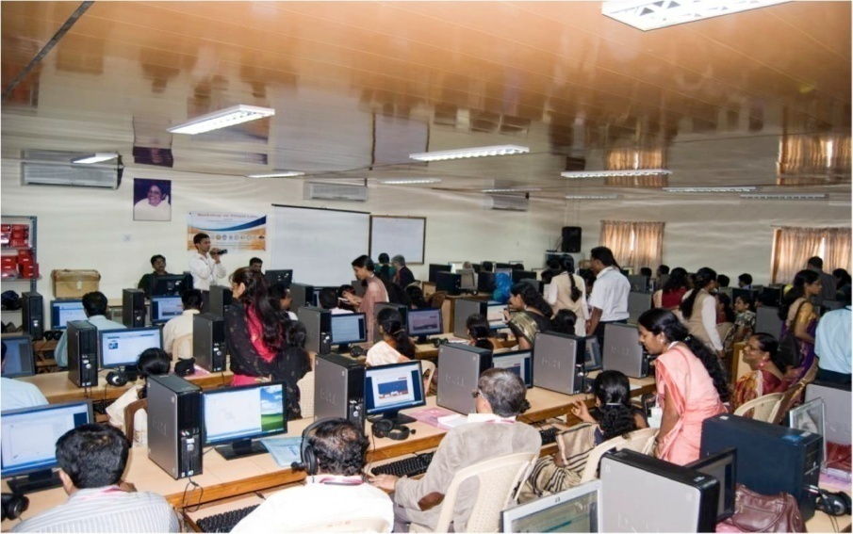
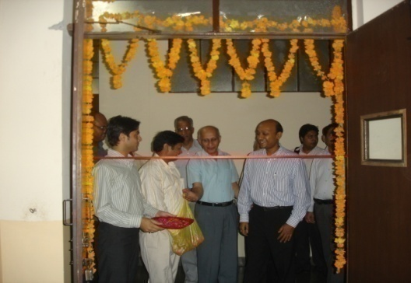
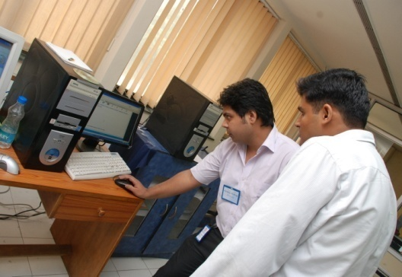
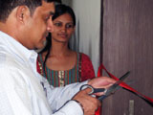
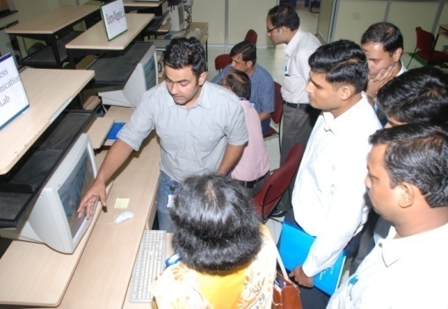
On-site Training and Field Trials

Slide 17
Usefulness
Usability
Learning Component
A novel process for Quality Control

Slide 18
The Feedback Loop
Lab Developer

Slide 19
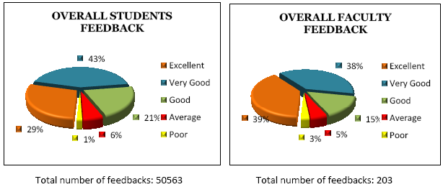
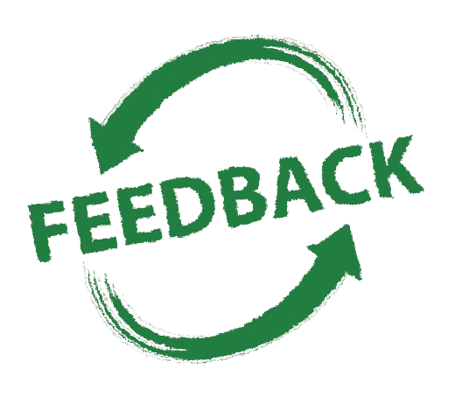
Analysis of Feedback

Slide 20
New paradigm for Transparency and Openness

Slide 21


THE ECO-SYSTEM
Creation of an Ecosystem and the Virtual Labs Community

Slide 22
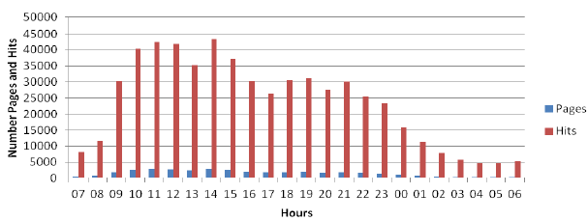

Success Indicators
Success Indicator Before After
Number of Virtual Labs developed 0 Over 100
Number of students using Virtual Labs 0 Over 50,000
Number of teachers trained on Virtual Labs 0 Over 1000
Number of engineering labs with a complete 0 Over 100
Learning Management System
Usage of Labs outside the Lab Hours 0 Over 1000
daily hits
1 – 30 Nov 2012
Phenomenal use beyond regular lab hours !

Slide 23
Best Practices
Novel Process for Quality Control
Novel Process for Field Trials
New Paradigm for Transparency
Creation of an Ecosystem
Learning Management System for Virtual Labs
Exemplary Horizontal Transfer of ICT-based Best Practices

Slide 24
Social Impact
Sharing of Lab Resources
Connecting Rural and Remote Colleges
Paradigm Shift in ICT - based Learning
Platform for exchange of knowledge
Quality Improvement in Engineering Education
Providing access to Quality Labs to the less privileged

Slide 25

Overall Impact
Accessibility to Quality Labs
Development of Novel Processes
Platform for exchange of Information
Ideal application for Akash and NKN

Slide 26
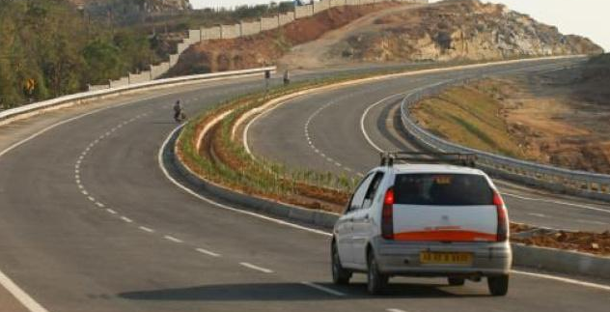
Thank You
Virtual Labs : A Journey
From Concept To Reality

